Slide 1

Attendance using Face Recognition
Email- mohammad_azaan.scsebtech@galgotiasuniversity.edu.in
Phone No- 8057717406
Team member details:-
Mohammad Azaan (19021011624)
Ansh Saxena (19021011674)
Mentor – Mr. S.P. Ramesh

Slide 2

Face Recognition
Face recognition is a method of recognising or validating someone's identity by glancing at their face. Face recognition software can recognise people in photos, movies, and real-time situations. Officers may use mobile devices to identify people during police stops.
Face recognition software use computer algorithms to identify specific, distinguishing features on a person's face. These features, such as eye distance or chin shape, are then transformed into a mathematical representation and compared to data from other faces in a face recognition database. A face template is data on a specific face that differs from an image in that it is designed to only include certain traits that can be used to recognise one face from another.

Slide 3
Attendance using Face Recognition
The proposed technique aims to automate diverse organizations attendance while simultaneously resolving the drawbacks of the current manual methodology. The system calculates attendance subject by topic, which means the administrator manually enters the data of students and subjects, and when the time for the relevant subject arrives, the system automatically snaps images and determines whether or not human faces are in the image.
The initial step in face recognition is the detection of faces, followed by the identification of those detected face images against a database. Face detection and recognition technologies have been presented in a variety of ways. Face recognition can be done in two ways: appearance-based, which includes geometric characteristics like the eyes, nose, eye brows, and cheeks, or feature-based, which includes geometric features like the eyes, nose, eye brows, and cheeks.

Slide 4

Importance of Attendance using Face Recognition
The implementation of an attendance management system using facial recognition for attendance marking is a logical method. Face recognition is more exact and faster than other systems, and it reduces the danger of proxy attendance. Face recognition enables for passive identification, which means that the person being identified does not have to do anything to be recognised.

Slide 5
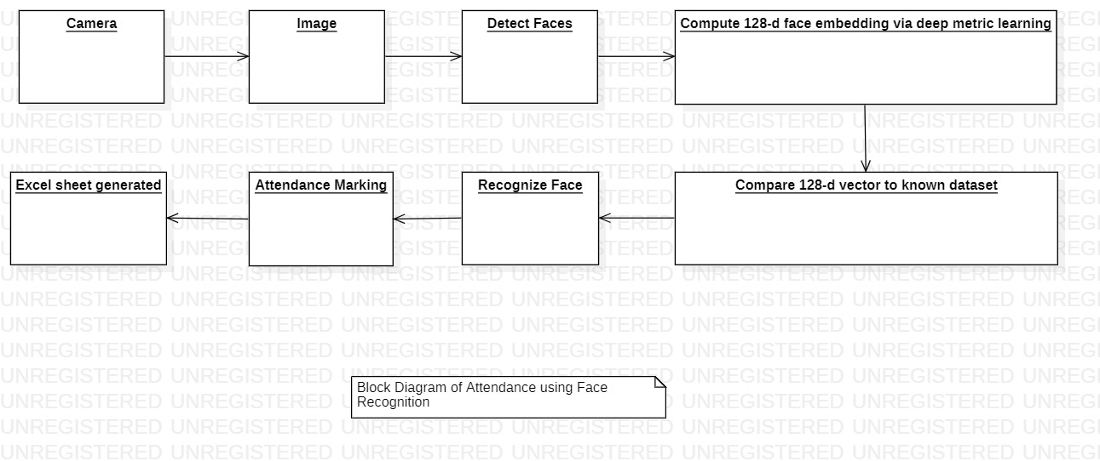
Implementation

Slide 6
Implementation
Face Detection and Extraction: Face detection is significant because when an image is taken with a camera and given to the system, a face detection technique is used to identify the human faces in that image. A variety of image processing algorithms are used to recognise faces in an image as well as their location.
Face Positioning: In a human face, there are 68 distinct points. To put it another way, there are 68 face landmarks. This step's main purpose is to recognise face landmarks and position the image. To automatically detect face landmarks and position the face as much as feasible without distorting the image, a python script is utilised.
Face Encoding: Following the detection of faces in a given image, the following step is to extract each image's unique identifying facial feature. Whenever we acquire a face localization, we extract 128 key facial points for each image input that are very accurate, and we save these 128-d facial points in a data file for face recognition.

Slide 7
Implementation
Face matching: It will proceed to attendance marking if the current image meets the 60% criteria with the existing dataset.
Attendance Marking: When the face is recognised by the image saved in the JSON file, Python generates roll numbers for current students and returns them. When the data is returned, the system generates an attendance table containing the name, roll number, date, day, and hour, as well as the related topic id. The data is then passed to Python, which automatically stores the table in an Excel file.

Slide 8
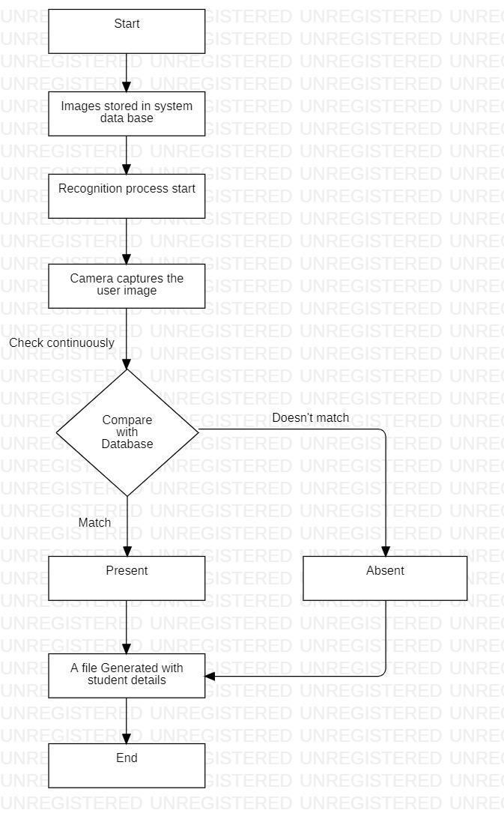
Architecture Diagram

Slide 9
Architecture Diagram
As shown in Figure, the proposed framework consists of three major steps : Data capturing , Data processing and Updating. In the defined proposal we are firstly storing the images into the database so that in the next step recognition process can be started. After this the work of the project starts where the image is being captured of the user during the run time which is then compared with the given database. If it matches with the following database the user is marked as present and if it doesn’t match it is marked as absent. And in the last step the file is generated with the student details for the given class or process.

Slide 10

Database

Slide 11
Model
In this model, we're building a facial recognition system for attendance using machine learning and Python. With the help of this project, we can detect whether someone is present or absent at work or in a school. As you may be aware, Artificial Intelligence and Machine Learning are guiding and shaping a new world. As a result, in order to save time and human effort, we decided to design a model that would allow us to rapidly recognise a person's absence or presence in the workplace or in educational environments such as schools and universities.

Slide 12
CONCLUSION
In this project, we employed the facial recognition concept to track student attendance and improve the system. The method works well in a variety of stances and variations. We attempted to propose a ground-breaking approach to attendance tracking that makes use of artificial intelligence tools. The goal of developing this system is to digitise the old method of recording attendance by calling names and keeping pen-and-paper records. The current methods for taking attendance are inconvenient and time-consuming. Manual recording allows for easy manipulation of attendance records. Traditional attendance systems and current biometric technologies are subject to proxies. As a result, we used the Smart Attendance Management System, which was created to address the shortcomings of traditional manual systems. Our research shows that using the recommended strategy, we can attain promising results.

Slide 13
THANK YOU

